Slide 1
9-X
exec & fork
System Calls

Slide 2
exec Commands
exec() = a generic name
execve(pathname, argv, envp) (LPI p.514)
loads a new program and environment
into the process’s memory
execvp(filename, argv[] )
execlp(filename, arg, …)
execl(filename, arg, …)
execv(filename, argv[] )
execle(pathname, arg, …) (LPI p.567)
Note: None of the above returns on success; all return -1 on error.

Slide 3
The naming convention: exec*
'l' indicates a list arrangement (a series of null terminated
arguments)
'v' indicate the array or vector arrangement (like the argv
structure).
'e' indicates the programmer will construct (in the
array/vector format) and pass their own environment
variable list
'p' indicates the current PATH string should be used when the
system searches for executable files.
NOTE:
In the four system calls where the PATH string is not used
(execl, execv, execle, and execve) the path to the program to be
executed must be fully specified.

Slide 4
exec System Call Functionality
Library Call Name | Argument List | Pass Current Environment Variables | Search PATH automatic?
execl | list | yes | no
execv | array | yes | no
execle | list | no | no
execve | array | no | no
execlp | list | yes | yes
execvp | array | yes | yes
http://www.cs.uregina.ca/Links/class-info/330/Fork/fork.html#exec

Slide 5
Things to remember about exec*:
This system call simply replaces the current process with a new program -- the pid does not change
The exec() is issued by the calling process and what is exec'ed is referred to as the new program -- not the new process since no new process is created
It is important to realize that control is not passed back to the calling process unless an error occurred with the exec() call
In the case of an error, the exec() returns a value back to the calling process
If no error occurs, the calling process is lost
http://www.cs.uregina.ca/Links/class-info/330/Fork/fork.html#exec

Slide 6
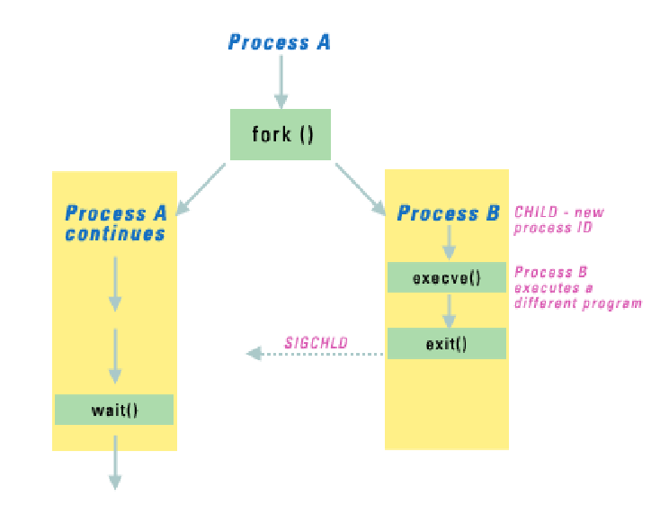
fork() as a diagram – what we ‘ve known

Slide 7
fork() – Output
Program’s output:
Which will it do?
A) Hello
Goodbye
B) Hello
Goodbye
Goodbye
C) Hello
Goodbye
Goodbye
Goodbye
……..
#include <stdio.h>
#include <sys/types.h>
#include <unistd.h>
int main() {
pid_t pid; /* could be int */
printf("Hello\n");
pid = fork();
printf("Goodbye\n");
}
~
fork1.c
Notes:
(b)

Slide 8
fork() – Who prints what ?
#include <stdio.h>
#include <sys/types.h>
#include <unistd.h>
int main() {
pid_t pid; /* could be int */
printf("Hello\n");
pid = fork();
if (pid == 0)
printf("Child: Goodbye\n");
else
printf("Parent: Goodbye\n");
}
Program’s Output:
Which will it do?
A)
Hello
Parent: Goodbye
Child: Goodbye
B)
Hello
Parent: Goodbye
C)
Hello
Child: Goodbye
fork2.c
Notes:
(a) Order might be reversed

Slide 9
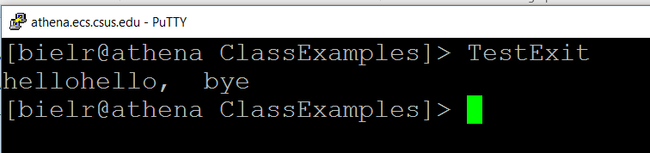

Example 1
#include <stdio.h>
#include <stdlib.h>
#include <unistd.h>
int main () {
int status;
printf("hello");
pid_t pid = fork();
if (pid == 0) {
sleep (2);
exit(0);
} else {
wait(&status);
printf(“, bye\n");
}
exit(0);
}
What is going on here? Why there are
two hellos displayed ?
TestExit.c
TestExit2.c
Notes:
csc60/ClassExamples/TestExit use capital letters.

Slide 10
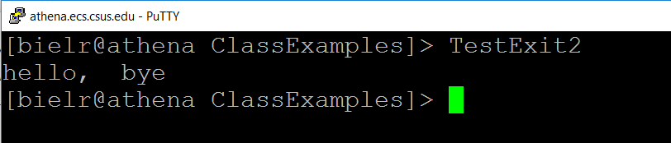
Example 2
#include <stdio.h>
#include <stdlib.h>
#include <unistd.h>
int main () {
int status;
printf("hello");
pid_t pid = fork();
if (pid == 0) {
sleep (2);
_exit(0);
} else {
wait(&status);
printf(“, bye\n");
}
exit(0);
}
Make more sense!
Notes:
csc60/ClassExamples/TestExit2

Slide 11
fork() – parent waits for child ?
…………..
printf("Hello\n");
pid = fork();
if (pid == 0) {
printf("Child: Goodbye\n");
sleep(2); // sleep 2 seconds
}
else {
if (wait(&status) == -1)
perror("Shell Program error");
else
printf("Child returned: %d\n",
WEXITSTATUS(status));
}
Program’s Output:
Hello
Child: Goodbye
Child returned: 0
What does the parent process do?
What does the child process do?
fork3.c
Notes:
Parent= hello. Child = goodbye. Parent = child returned. (or ERROR).

Slide 12
Execute a command via argument passing from argv
/* Program to execute a command using an argument from argv */
#include <stdio.h>
#include <unistd.h>
int main (int argc, char *argv[])
{
if (argc != 2) {
printf("Usage: input a command name with no option i.e. ls \n");
return 0;
}
printf("About to run: %s \n", argv[1]);
char *cmd[] = {argv[1], 0 }; /* make sure place a 0 at the end of
array of pointer cmd */
execvp(cmd[0], cmd);
return 0;
}
argv.c
Notes:
2nd from end: cmd[0] = the command to run [ls]
cmd= the argument list (argv) { ls, null]
argv[0] = a.out
argv[1] = ls
argv[[2] = null ?
(cmd[0], cmd). ls = first argument; command to execute
ls = second argument; contents of the argv when it runs
/* From/home/ftp/nguyendh/lab4 */

Slide 13
The output of argv.c
[bielr@sp1 ClassExamples]> argv ls
About to run: ls
argv fork1 globvar.out strspn_example
argv.c fork1.c infloop strspn_example.c
count_chars fork2 infloop.c Text1.dat
count_chars.c fork2.c ouch thread
count_words fork3 ouch.c thread.c
count_words.c fork3.c pause tlpi_hdr.h
data-file getenv_putenv pause.c waitpid
environ getenv_putenv.c shfile waitpid.c
environ.c globex shfile.c word_count.c
error_functions.h globex.c shfile.out word_counts.c
[bielr@sp1 ClassExamples]>

Slide 14
Review I/O Redirection

Slide 15
First, review a program from C7 named sincos
Notes:
sincos.c

Slide 16
Example Trigonometric Functions
// prints tables showing the values of cos,sin
#include <math.h>
#include <stdio.h>
#include <stdlib.h>
void tabulate(double (*f)(double), double first, double last, double incr);
int main(void) {
double final, increment, initial;
printf (“Enter initial value: “);
scanf (“%lf”, &initial);
printf (“Enter final value: “);
scanf (%lf”, &final);
printf (“Enter increment : “);
scanf (%lf”, &increment);
printf(“\n x cos(x) \n”
“ ---------- -----------\n”);
tabulate(cos, initial,final,increment);
printf(“\n x sin (x) \n”
“ ---------- -----------\n”);
tabulate(sin, initial,final,increment);
return (EXIT_SUCCESS);
}
The main function in little print.
Bigger print used in following
slides.

Slide 17
Example Trigonometric Functions (1 of 4)
// prints tables showing the values of cos, sin
#include <math.h>
#include <stdio.h>
#include <stdlib.h>
void tabulate(double (*f)(double), double first,
double last, double incr);
int main(void)

Slide 18
Example Trigonometric Functions (2 of 4)
int main(void)
{
double final, increment, initial;
// Enter the data at the keyboard
printf (“Enter initial value: “);
scanf (“%lf”, &initial);
printf (“Enter final value: “);
scanf (%lf”, &final);
printf (“Enter increment : “);
scanf (%lf”, &increment);

Slide 19
Example Trigonometric Functions (3 of 4)
// Print the headers and call tabulate
printf(“\n x cos(x) \n”
“ ---------- -----------\n”);
tabulate(cos, initial,final,increment);
printf(“\n x sin (x) \n”
“ ---------- -----------\n”);
tabulate(sin, initial,final,increment);
return (EXIT_SUCCESS);
}

Slide 20
Trigonometric Functions (4 of 4)
// when passed a pointer f, the function prints a table
// showing the value of f
void tabulate(double (*f) (double), double first,
double last, double incr)
{
double x;
int i, num_intervals;
num_intervals = ceil ( (last -first) /incr );
for (i=0; i<=num_intervals; i++) {
x= first +i * incr;
printf(“%10.5f %10.5f\n”, x , (*f) (x));
}
}

Slide 21
Enter initial value: 0
Enter final value: .5
Enter increment: .1
X cos(x)
---------- -----------
0.00000 1.00000
0.10000 0.99500
0.20000 0.98007
0.30000 0.95534
0.40000 0.92106
0.50000 0.87758
X sin(x)
---------- -----------
0.00000 0.00000
0.10000 0.09983
0.20000 0.19867
0.30000 0.29552
0.40000 0.38942
0.50000 0.47943
Output
of
the
Example

Slide 22
Two redirection examples:
1) ls > out.txt
2) sincos < input.txt
In input.txt:
5.0 - initial value
10.0 - final value
1.0 - increment value

Slide 23
Redirection of standard output (redir.c)
Example: implement shell to do: ls > x.lis
What happens inside:
(1) Open a new file x.lis
(2) Redirect standard output to x.lis using dup2 command
Everything sent to standard output ends in x.lis
(3) execute ls in the process
dup2(int fin, int fout) - copies fin to fout in the file table
File descriptor table
dup2(3,1)
stdin
stdin
0
1
2
3
4
0
1
2
3
4
stdout
stderr
x.lis
x.lis

Slide 24
Note about the next program
It uses the CREAT call…to create a file that does not exist.
It is becoming antiquated.
fileID = creat( "x.lis",0640 ); // 0640 is the mode
To do the call with OPEN, we would type:
fileID = open ( "x.lis", O_WRONLY | O_CREAT | O_TRUNC,
S_IRUSR | S_IWUSR | S_IRGRP);
0640 = 0400 (User_read) + 0200 (User-write) + 040 (Group-read)
The mode for file permission bits is explained in a chart on
LPI page 295.

Slide 25
Constants for file permission bits
Constant | Octal value | Permission bit
S_ISUID | 04000 | Set-user-ID
S_ISGID | 02000 | Set-group-ID
S_ISVTX | 01000 | Sticky
S_IRUSR | 0400 | User-read
S_IWUSR | 0200 | User-write
S_IXUSR | 0100 | User-execute
S_IRGRP | 040 | Group-read
S_IWGRP | 020 | Group-write
S_IXGRP | 010 | Group-execute
S_IROTH | 04 | Other-read
S_IWOTH | 02 | Other-write
S_IXOTH | 01 | Other-execute

Slide 26
Code Example - implement ls > x.lis
/* fileID, code file = redir.c */
#include <unistd.h>
int main (void)
{
int fileID;
fileID = creat( "x.lis",0640 ); // 0640 is the mode
if( fileID < 0 ) {
printf( "error creating x.lis\n " );
exit (1);
}
dup2( fileID, stdout ); /* copy fileID to stdout */
close( fileID );
execl( "/bin/ls", "ls", 0 ); return EXIT_SUCCESS;
}

Slide 27
User and Group ID

Slide 28
User and Group ID (1 of 2)
Each process has three Ids
(1) Real user ID (RUID)
used to determine which user started the process
Same as the user ID of parent (unless changed)
(2) Effective user ID (EUID)
Used to assign ownership of newly created files
to check file access permissions
to check permission to send signals to processes.
Two ways to change: from set user ID bit on the file being executed, or system call
(3) Saved user ID (SUID)
So previous EUID can be restored

Slide 29
User and Group ID (2 of 2)
Notes:
Real and effective uid: inherit (fork),
maintain (exec).
Normally, effective user and effective group user ids have the same value as real user ids except when we change it (in two ways)
Real group ID, effective group ID, used similarly .

Slide 30

Type of Users in Linux System (optional)
* Super User (or Root) – uid 0
* System User – uid 1-499
* Regular User – uid: 500 < 6000
* Network User – uid > 6000
* Pseudo User – Replica of Super User
User changes password ? i.e use passwd

Slide 31
Recall: Unix file security
Each file has owner and group
Permissions set by owner
Read, write, execute
Owner, group, other
Represented by vector of
four octal values
Only owner, root can change permissions
This privilege cannot be delegated or shared
setid
-
rwx
rwx
rwx
ownr
grp
othr

Slide 32
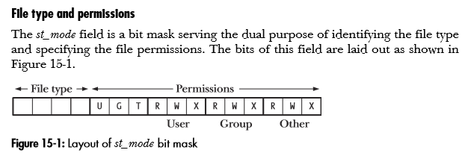
Recall: Special note on File type and permissions
Set-UID
Set-GID
LPI (Page 281)
Notes:
set UID, set GID apply to an executable
They make the effective ID match the owner/group of the file when the program runs
S or s in the x position indicate the set ID option

Slide 33
Side Note.
After the Set-UID and Set-GID bits on the previous slide, there is a bit labeled “T”;
That stands for Sticky Bit.
A sticky bit is a permission bit that is set on a directory that allows only the owner of the file within that directory or the root user to delete or rename the file.
No other user has the needed privileges to delete the file created by some other user.
(More on page 300 in TLPI)

Slide 34
First Option: Set User ID Bit
Owner sets it with chmod
u – user/owner; g – group; o – all other users
chmod u+x executable_file
-rwx------ executable_file
chmod u+s executable_file
-rws------ executable_file
Notes:
S or s in the x position indicate the set ID option

Slide 35
From TLPI, page 300:
On older UNIX implementations, the sticky bit was provided as a way of making commonly used programs run faster. If the sticky bit was set on a program file, then the first time the program was executed, a copy of the program text was saved in the swap area—thus it sticks in swap and loads faster on subsequent executions. Modern UNIX implementations have more sophisticated memory-management systems, which have rendered this use of the sticky permission bit obsolete.
The name of the constant for the sticky permission bit shown in Table 15-4, S_ISVTX, derives from an alternative name for the sticky bit: the saved-text bit.

Slide 36
More from page 300, TLPI
In modern UNIX implementations (including Linux), the sticky permission bit serves another, quite different purpose. For directories, the sticky bit acts as the restricted deletion flag.
Setting this bit on a directory means that an unprivileged process can unlink (unlink(), rmdir()) and rename (rename()) files in the directory only if it has write permission on the directory and owns either the file or the directory. (A process with the CAP_FOWNER capability can bypass the latter ownership check.)
This makes it possible to create a directory that is shared by many users, who can each create and delete their own files in the directory but can’t delete files owned by other users. The sticky permission bit is commonly set on the /tmp directory for this reason.

Slide 37
Process Operations and IDs
Root
ID=0 for superuser root; can access any file
Fork and Exec
Inherit three IDs
ID | Set-user-ID bit off | Set-user-ID bit on
RUID | Unchanged | Unchanged
EUID | Unchanged | Set from user ID of program file
SUID | Copied from EUID | Copied from EUID

Slide 38
Process Operations and IDs (1 of 2)
When a set-user-ID program is run (i.e. loaded into a process’s memory by an exec()), the kernel sets the effective user ID of the process to be the same as the user ID of the executable file.
Running a set-group-ID program has an analogous effect for the effective group ID of the process. Changing the effective user or group ID in this way gives a process (in other words, the user executing the program) privileges it would not normally have.
For example, if an executable file is owned by root (superuser) and has the set-user-ID permission bit enabled, then the process gains superuser privileges when that program is run. (LPI – P169)

Slide 39
Process Operations and IDs – Example (2 OF 2)
$ su
Password:
# chown root check_password Make this program owned by root.
#chmod u+s check_password With the set-user-ID bit enabled
# ls –l check_password
-rwsr-xr-x 1 root users 18150 Oct 28 10:49 check_password
# exit
$ whoami This is an unprivileged login.
Mtk
$ ./check_password But we can now access the shadow
Username: avr password file using this program
Password:
Successfully authenticated: UID=1001
LPI page 169-70

Slide 40
Second Option: setuid(uid) system calls
ID | Super user | Unprivileged user
RUID | Set to uid | Unchanged
EUID | Set to uid | Set to uid
SUID | Set to uid | unchanged

Slide 41
System calls: Read IDs
#include <unistd.h>
pid_t getuid(void);
Returns the real user ID of the current process
pid_t geteuid(void);
Returns the effective user ID of the current process
gid_t getgid(void);
Returns the real group ID of the current process
gid_t getegid(void);
Returns the effective group ID of the current process

Slide 42
System calls: Change UID and GID
#include <unistd.h>
int setuid( uid_t uid )
int setgid( gid_t gid )
Sets the effective user ID of the current process.
Superuser process resets the real effective user IDs to uid.
Non-superuser process can set effective user ID to uid, only
when uid equals real user ID or the saved set-user ID (set by
executing a setuid-program in exec).
In any other cases, setuid returns error.

Slide 43
Difference between: Real User ID Effective User ID Saved User ID
http://stackoverflow.com/questions/32455684/difference-between-real-user-id-effective-user-id-and-saved-user-id
or
http://tinyurl.com/z3eakft
The contents of the link are pasted into the next slides.

Slide 44
Page 1 of 2.
The distinction between a real and an effective user id is made because you may have the need to temporarily take another user's identity (most of the time, that would be root, but it could be any user). If you only had one user id, then there would be no way of changing back to your original user id afterwards (other than taking your word for granted, and in case you are root, using root's privileges to change to any user).
So, the real user id is who you really are (the one who owns the process), and the effective user id is what the operating system looks at to make a decision whether or not you are allowed to do something (most of the time, there are some exceptions).
When you log in, the login shell sets both the real and effective user id to the same value (your real user id) as supplied by the password file.

Slide 45
Page 2 of 2.
Now, it also happens that you execute a setuid program, and besides running as another user (e.g. root) the setuid program is also supposed to do something on your behalf. How does this work?
After executing the setuid program, it will have your real id (since you're the process owner) and the effective user id of the file owner (for example root) since it is setuid.
The program does whatever magic it needs to do with superuser privileges and then wants to do something on your behalf. That means, attempting to do something that you shouldn't be able to do should fail. How does it do that? Well, obviously by changing its effective user id to the real user id!
Now that setuid program has no way of switching back since all the kernel knows is your id and... your id. Bang, you're dead.
This is what the saved set-user id is for.

Slide 46
Some Applications of fork

Slide 47
Definitions
getty , short for "get tty", is a Unix program running on a host computer that manages physical or virtual terminals (TTYs). When it detects a connection, it prompts for a username and runs the 'login' program to authenticate the user.

Slide 48
Definition of init
init (short for initialization) is the first process started during booting of the computer system.
init is a daemon or background process that continues running until the system is shut down.
It is the direct or indirect ancestor of all other processes and automatically adopts all orphaned processes.
init is started by the kernel using a hard-coded filename; a kernel panic will occur if the kernel is unable to start it.
init is typically assigned process identifier 1.

Slide 49
Definitions
.
login - is used when signing onto a system. If no argument is given, login prompts for the username

Slide 50
Unix Start Up Processes Diagram
OS kernel
Process 0
(sched)
Process 1
(init)
getty
getty
getty
C shell
login
Bash shell
login
csh
bash
Notes:
Note: RLIMIT_NPROC

Slide 51
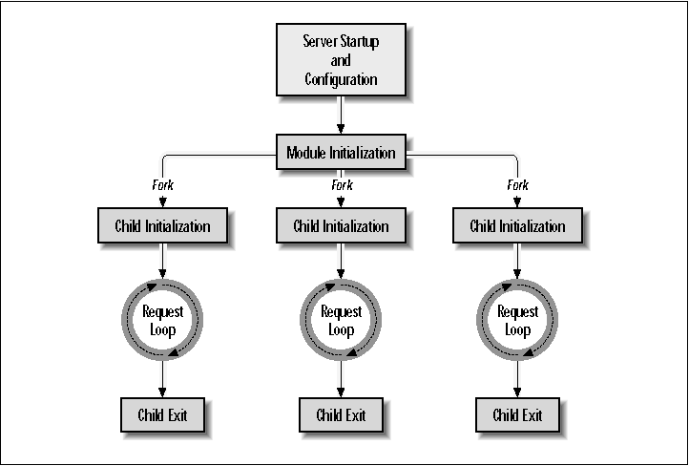
Apache Web Server
Source: http://docstore.mik.ua/orelly/apache_mod/24.htm
Notes:
Note: RLIMIT_NPROC

Slide 52
9-X
exec & fork System Calls
The End

